Slide 1
Parsing ARXML
ARXML
Tools
Data flow
Modification

Slide 2
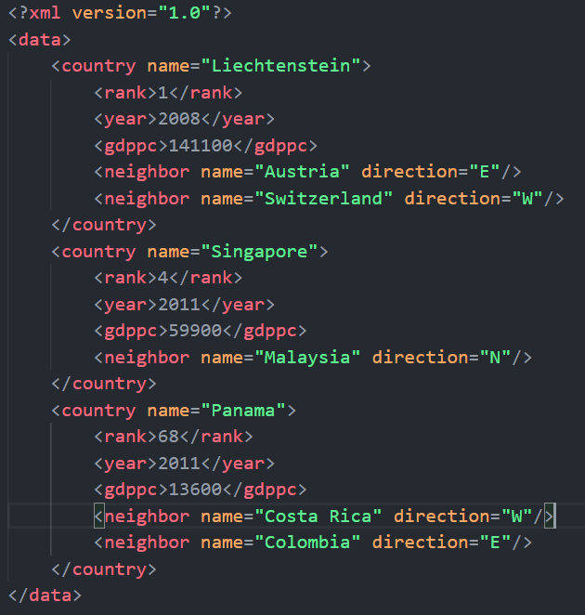
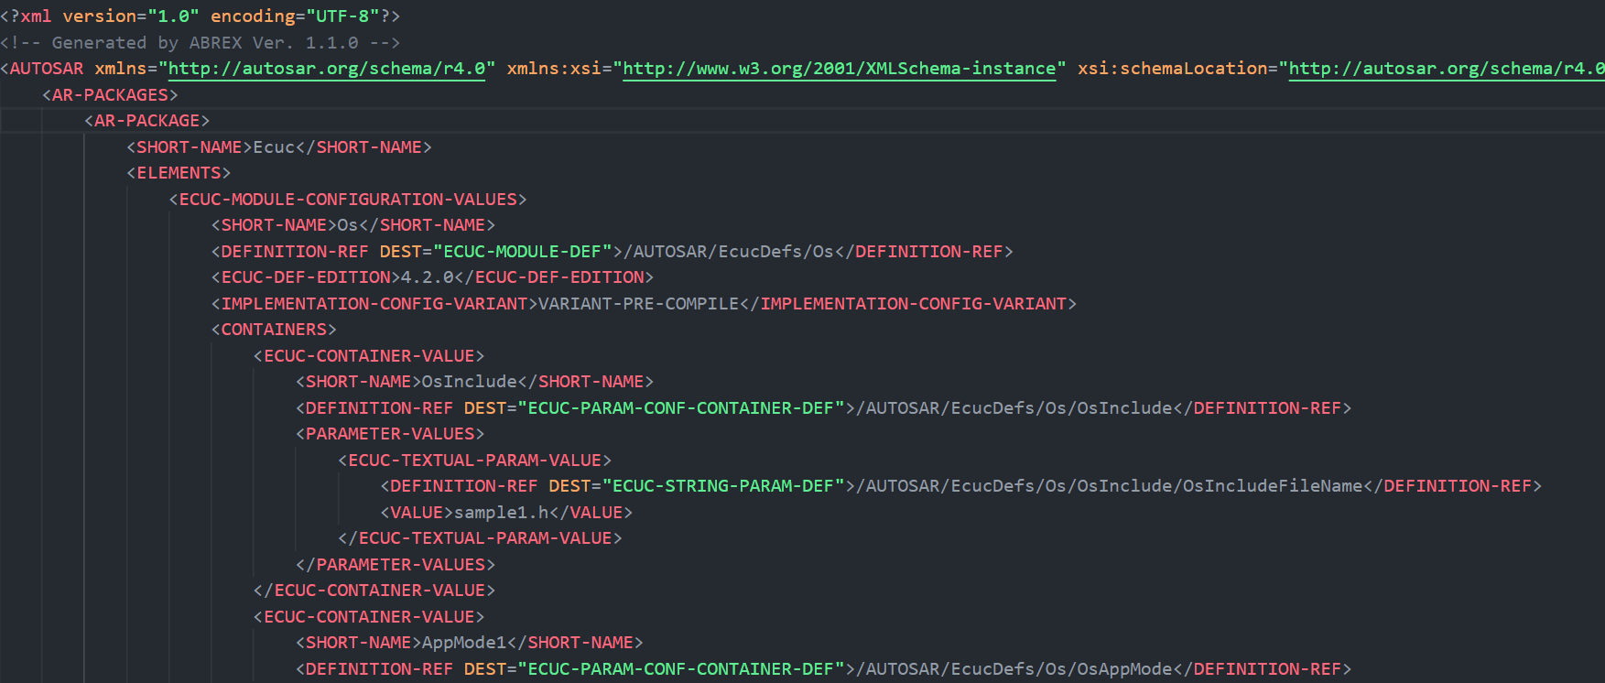
ARXML
Like XML file ARXML is the XML data file for Autosar
In XML the tags is designed by user’s
So if the tags types is all design for autosar, we call it ARXML
So we can parse arxml as xml

Slide 3
Data flow
Json
Tools
Modification
Arxml
oil
Example src:
Online examples
ARXML factory
Example src:
file1.oil
Declaration

Slide 4
The oil file
Part1: Implementation Definition
Implementaion-spec feature of an OSEK-OS
Example:
Basic & extended tasks used, single activation only, one task per priority
Part2: Application Definition
Structure and properties of application
Example:
8 tasks, 3 counter, 4 alarms, 6 resources, 5 events, etc...
Alarm_3 activate Task_3

Slide 5
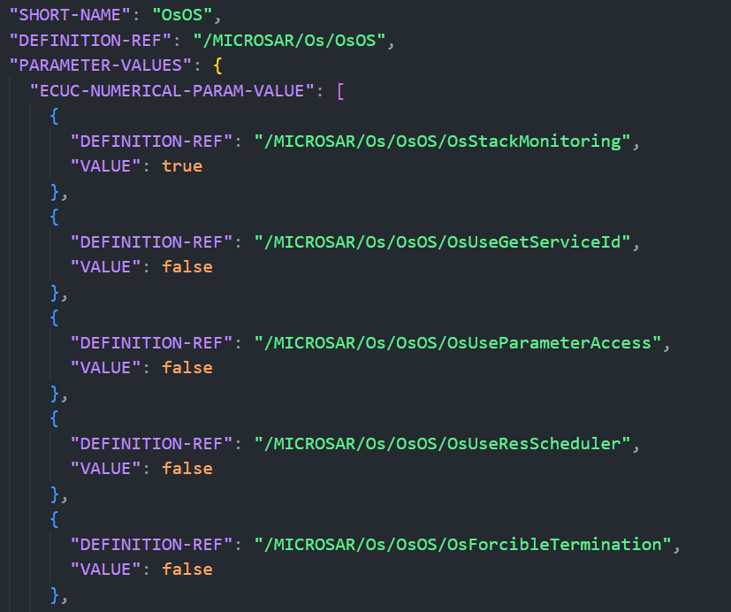
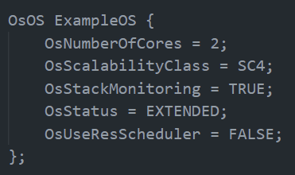
JSON modification
Get by JSON.parse()

Slide 6
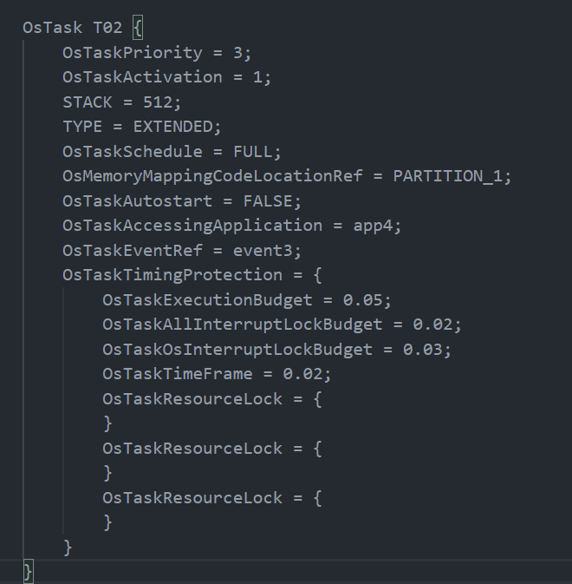
JSON modification -Progress-3/24
Can’t get the
multiple brace comment
Format modification

Slide 7
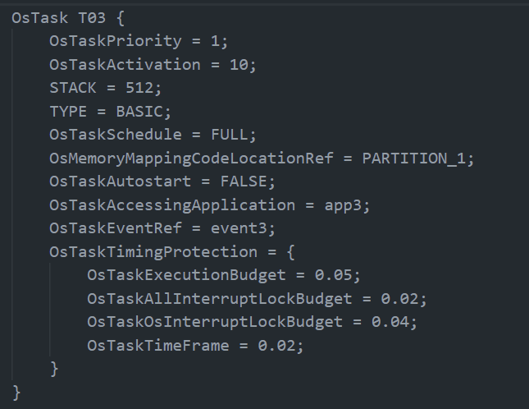
JSON modification-Progress-4/14
Solve the recursivly parsing problem
Solve the output format

Slide 8
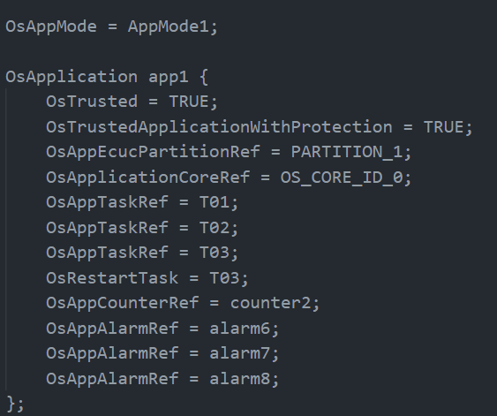
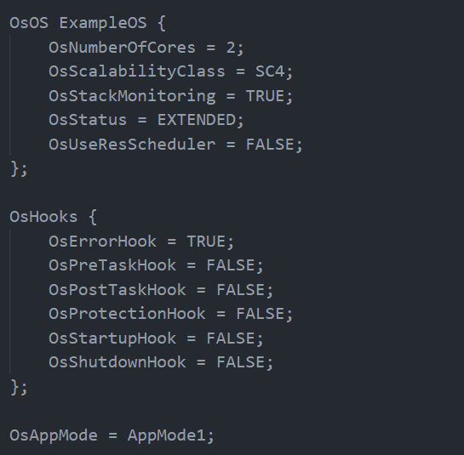
JSON modification-Progress-4/14
No arxml format for the assignment format
Haven’t run the full file of the arxml parsing, currently have been parsed by part.
The order of parsing?
Now: top down

Slide 9
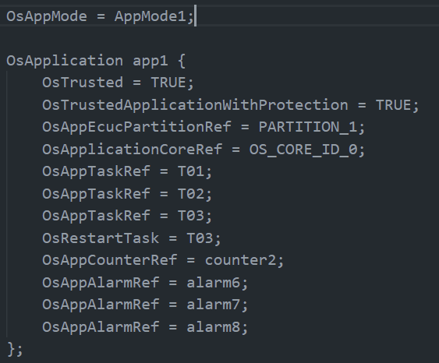
Declaration
Comparing to C declare and oil file, they are extremely similar.
Assignmernt
Class(Type) name
{
elements = vals;
…
};

Slide 10
XML2C Modification
Example output:
% xml2c sample.xml
struct _item {
char* id;
char* value;
char* TEXT;
};
struct _list {
struct _item item[3];
int N_item;
};
static struct _list list = {
{ {
"1",
"17",
"this item",
}, {
"2",
"23",
"that item",
}, {
"3",
"42",
"the other item",
} },
3,
};
Example input:
<?xml version="1.0" encoding="utf-8" ?>
<list>
<item id="1" value="17">this item</item>
<item id="2" value="23">that item</item>
<item id="3" value="42">the other item</item>
</list>

Slide 11
Tools
Converting to JSON: https://codebeautify.org/xmltojson
Coverting to C: http://acme.com/software/xml2c/

